Slide 1
Implementing and Evaluating MPTCP on the SCION Future Internet Architecture
Presentation master thesis
Michael A. Flückiger
August 28, 2020

Slide 2
Projektanalyse – Folie 2
On the menu
Introduction
Functionality of Shila
Performance evaluation
Future work
Notes:
Introduction: What ingredients? What? Why?
Shila: How? (Setup – Connection establishment – Data transfer)
Performance: How good?
Future work: What is next?

Slide 3
Projektanalyse – Folie 2
On the menu
Introduction
Functionality of Shila
Performance evaluation
Future work
Notes:
Introduction: What ingredients? What? Why?
Shila: How? (Setup – Connection establishment – Data transfer)
Performance: How good?
Future work: What is next?

Slide 4
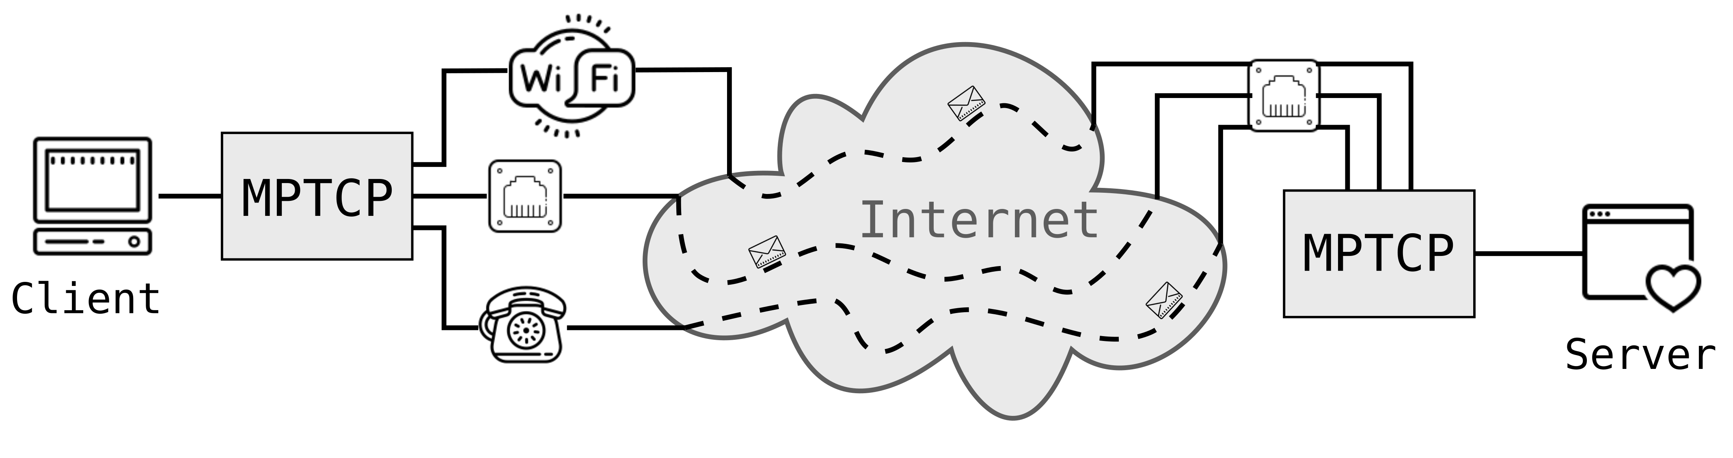
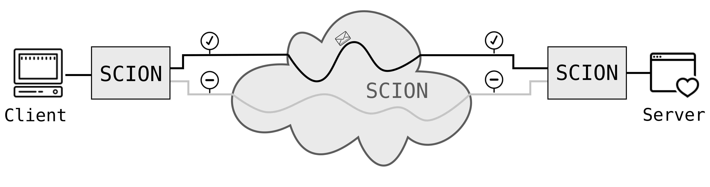
Projektanalyse – Folie 2
Introduction
Ingredients?
TCP (Transmission Control Protocol)
Dominant transport protocol in today’s Internet
One path per connection
MPTCP (Multipath TCP)
Extension to TCP
Multiple paths (flows) per connection
SCION (Scalability, Control and Isolation on next-generation networks)
More secure network architecture
Implements path transparency
Support for multiple paths
Notes:
MPTCP: Usage of all available network interfaces
SCION: Successor of today’s Internet (hopefully ☺)

Slide 5
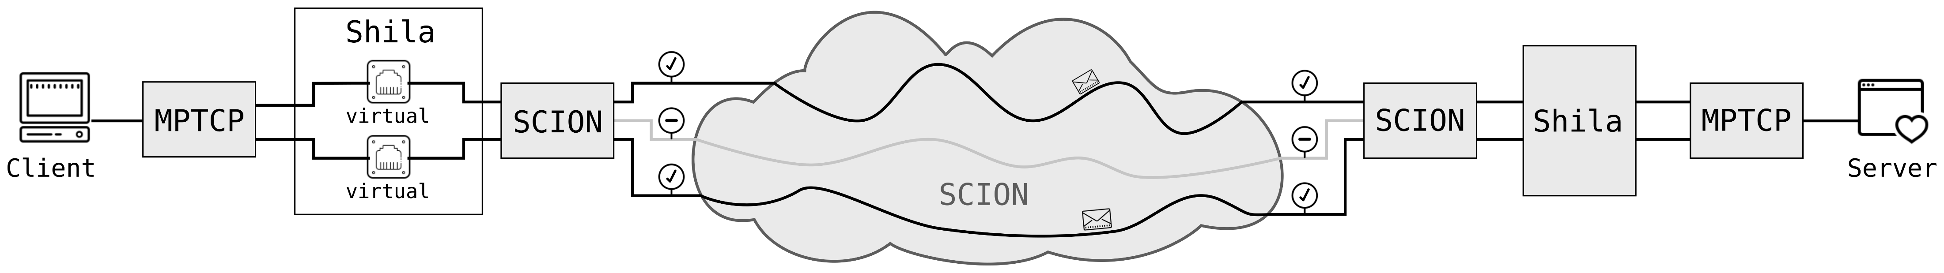
Projektanalyse – Folie 2
Introduction
What?
Main objective and contribution of the presented work:
Implementation (and evaluation) of a shim layer that
allows the usage of MPTCP over SCION.
Notes:
Introduction to Shila. We name our implementation of the shim layer „Shila“

Slide 6
Projektanalyse – Folie 2
Introduction
Why?
Facilitates promotion and development of SCION
Straightforward use TCP applications over SCION
Benefit for endpoints with MPTCP support
Increase of redundancy thanks to multiple paths
Potential through mediating role of Shila in between
Shila is aware and under control of paths used through SCION
Notes:
Easy to use, no changes necessary, user can use his favorite TCP application without having to change alot
Connection with MPTCP over SCION benefits from multiple paths (redundancy) even if there is just one real interface available (at least from path redundance, not from connection redudancy)
Could for example be used to use less consevative congestion contol, w.r.t fairness

Slide 7
Projektanalyse – Folie 2
On the menu
Introduction
Functionality of Shila
Performance evaluation
Future work
Notes:
Introduction: What ingredients? What? Why?
Shila: How? (Setup – Connection establishment – Data transfer)
Performance: How good?
Future work: What is next?

Slide 8
Projektanalyse – Folie 2
Functionality of Shila
Three Parts
Setup
Getting Shila ready to mediate between MPTCP and SCION
Connection establishment
Establish the connection between client and server of a TCP application
Main-Flow and Sub-Flows
Data exchange
Operational mode once connection is up
Notes:
Want to illustrate this three parts based on an running example..

Slide 9
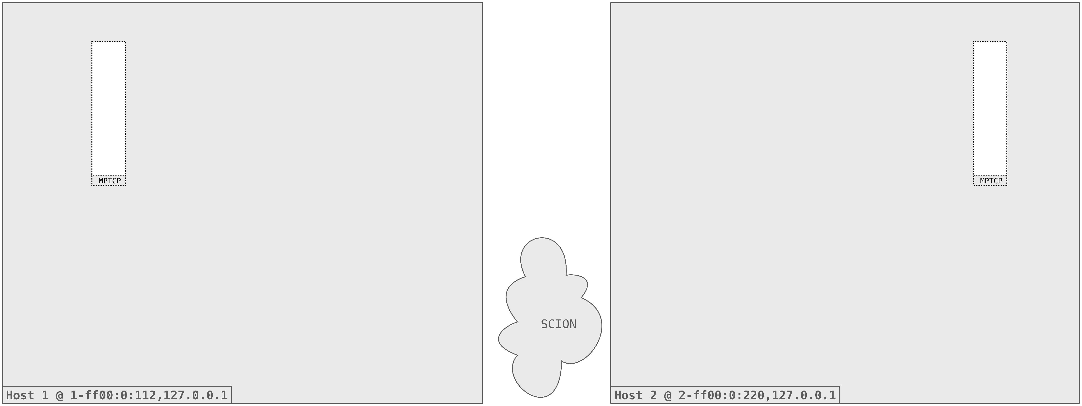
Projektanalyse – Folie 2
Functionality of Shila
Initial situation

Slide 10
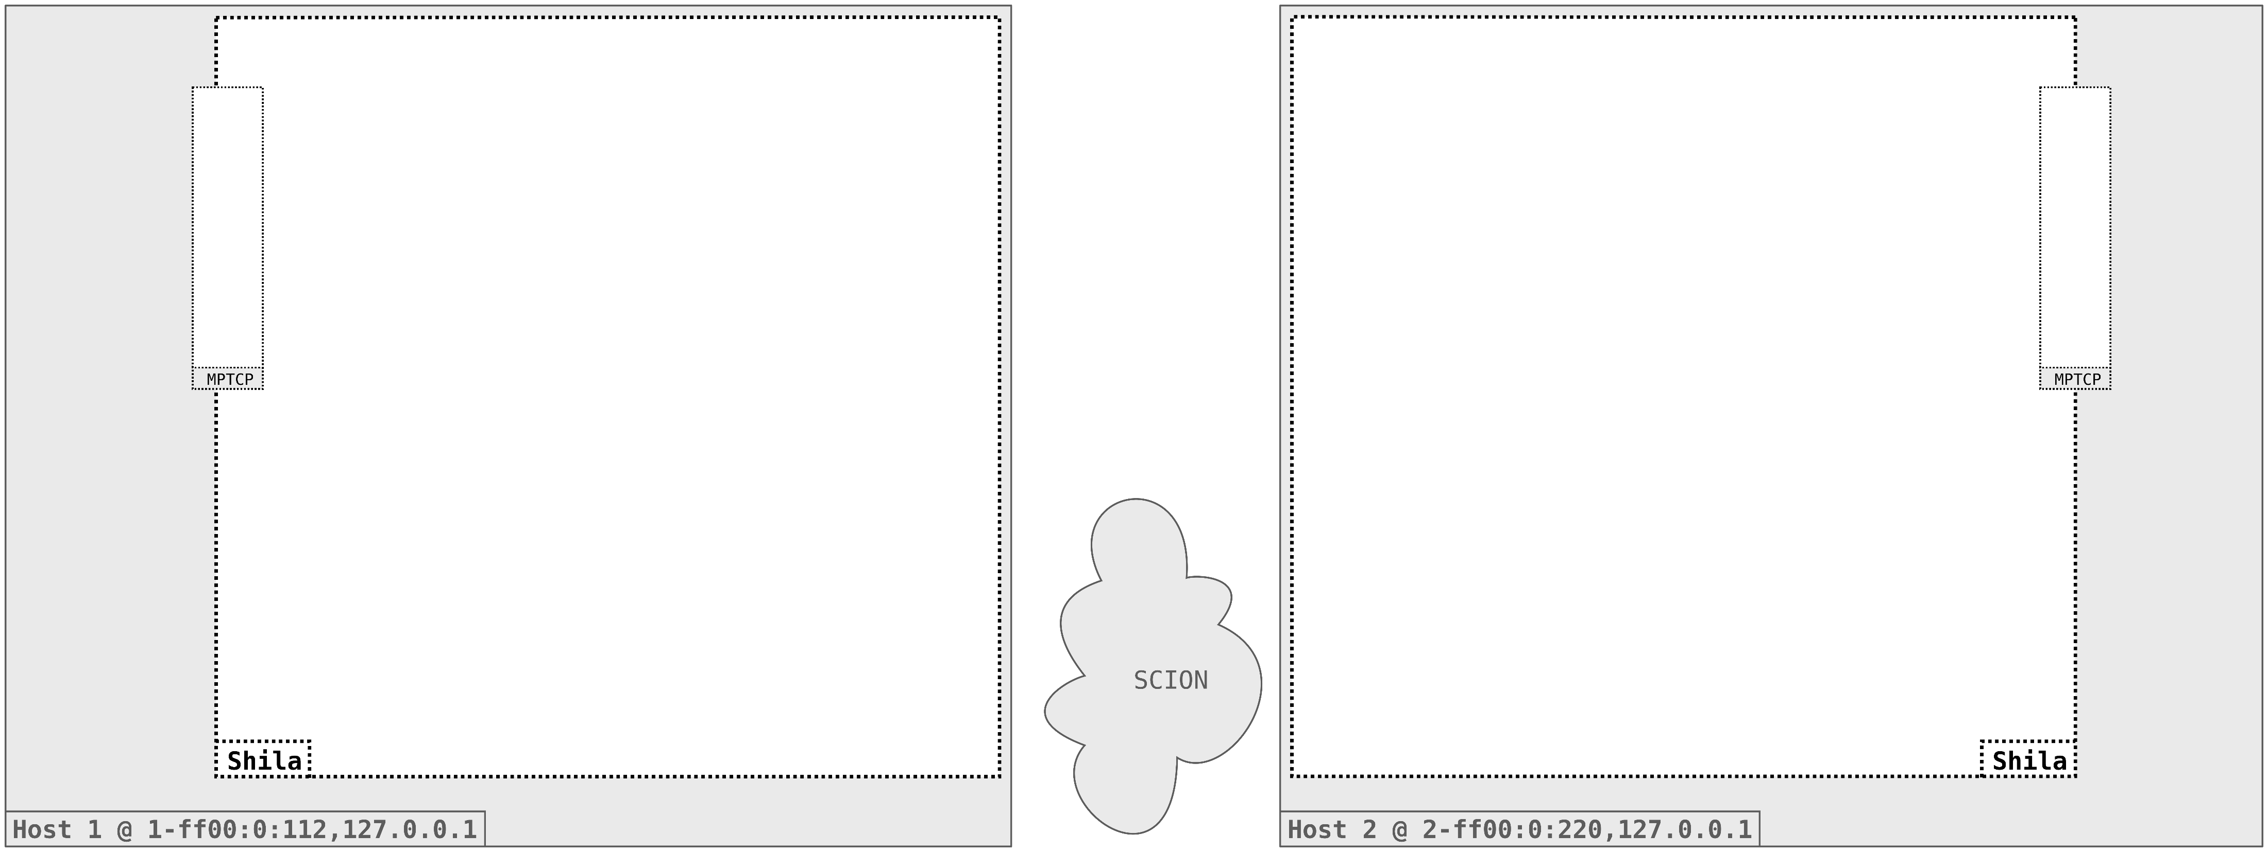
Projektanalyse – Folie 2
Functionality of Shila
Setup

Slide 11
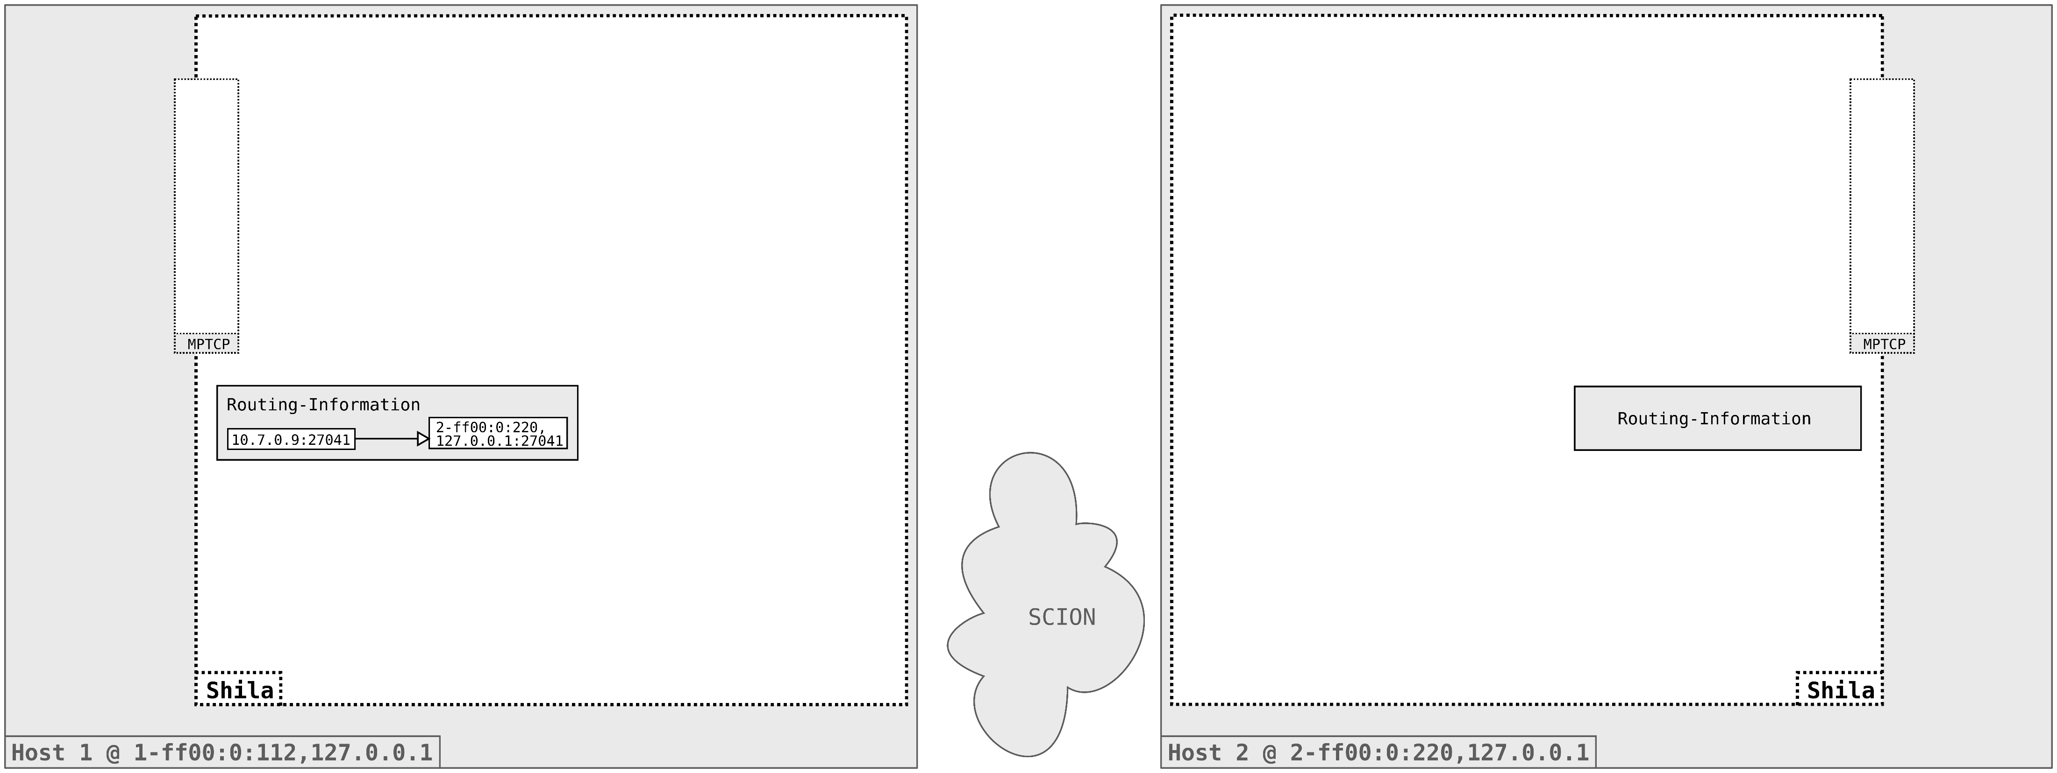
Projektanalyse – Folie 2
Functionality of Shila
Setup

Slide 12
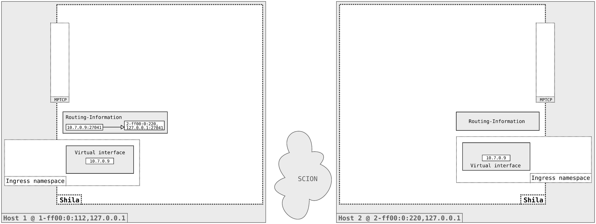
Projektanalyse – Folie 2
Functionality of Shila
Setup

Slide 13
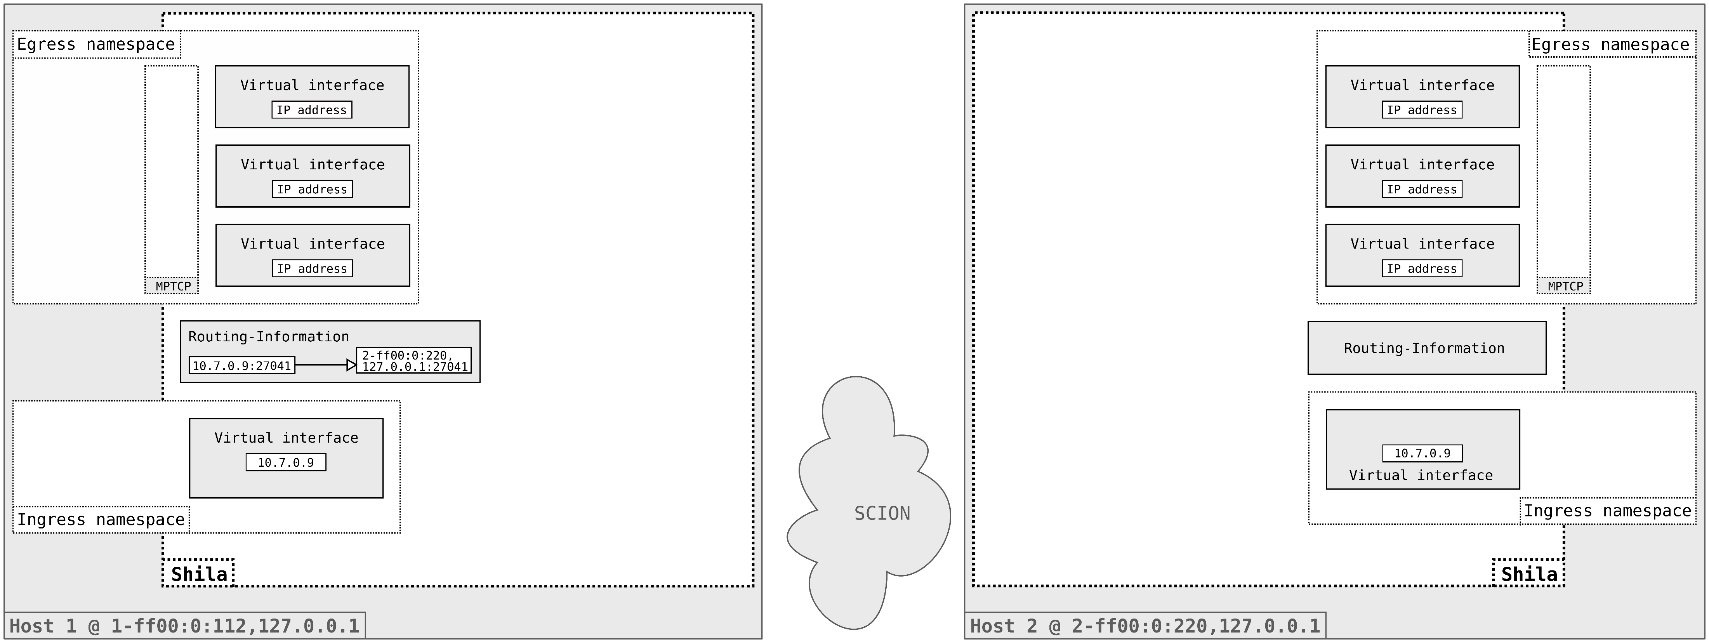
Projektanalyse – Folie 2
Functionality of Shila
Setup

Slide 14

Projektanalyse – Folie 2
Functionality of Shila
Setup

Slide 15
Projektanalyse – Folie 2
Functionality of Shila
Main-Flow Establishment

Slide 16
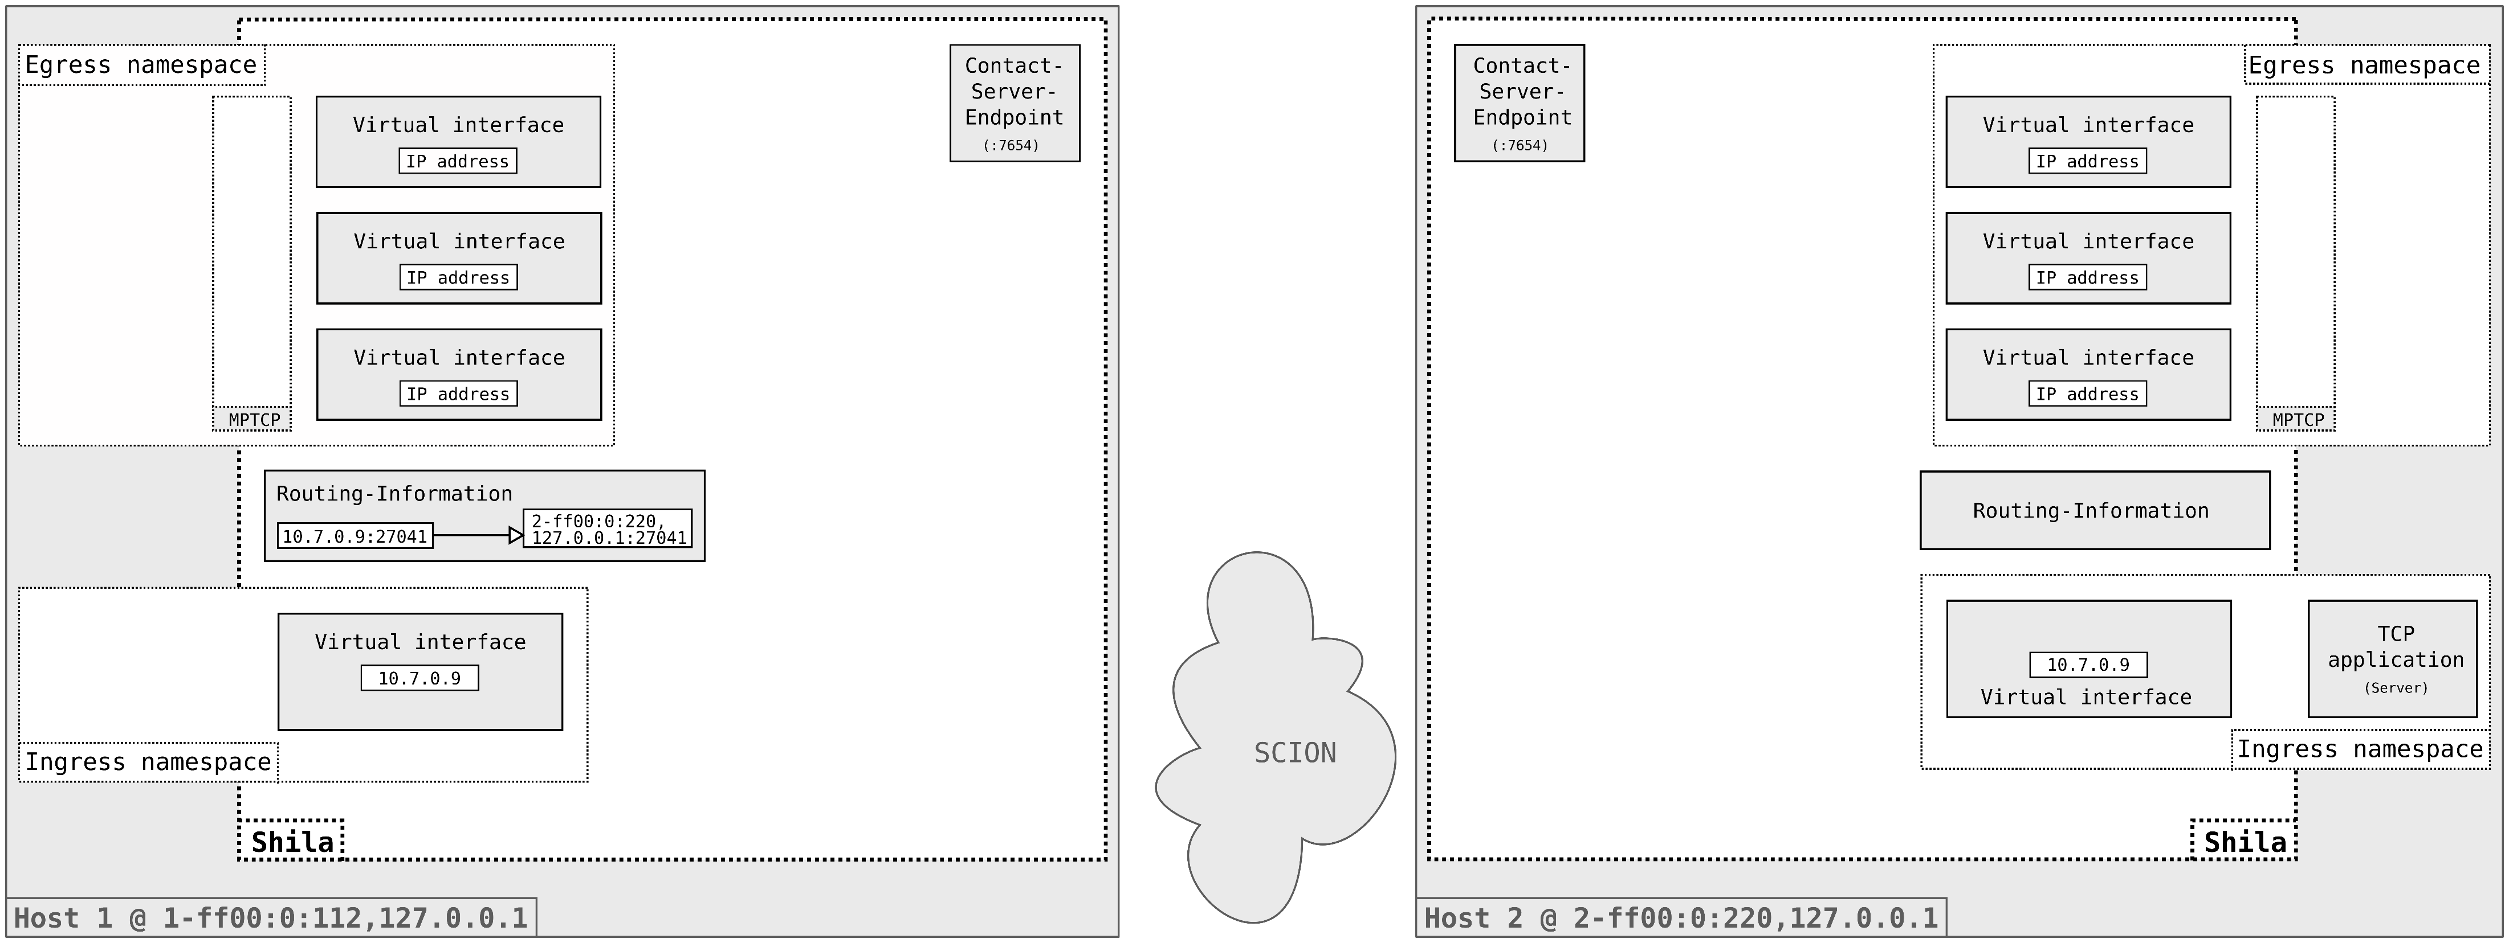
Projektanalyse – Folie 2
Functionality of Shila
Main-Flow Establishment

Slide 17

Projektanalyse – Folie 2
Functionality of Shila
Main-Flow Establishment

Slide 18
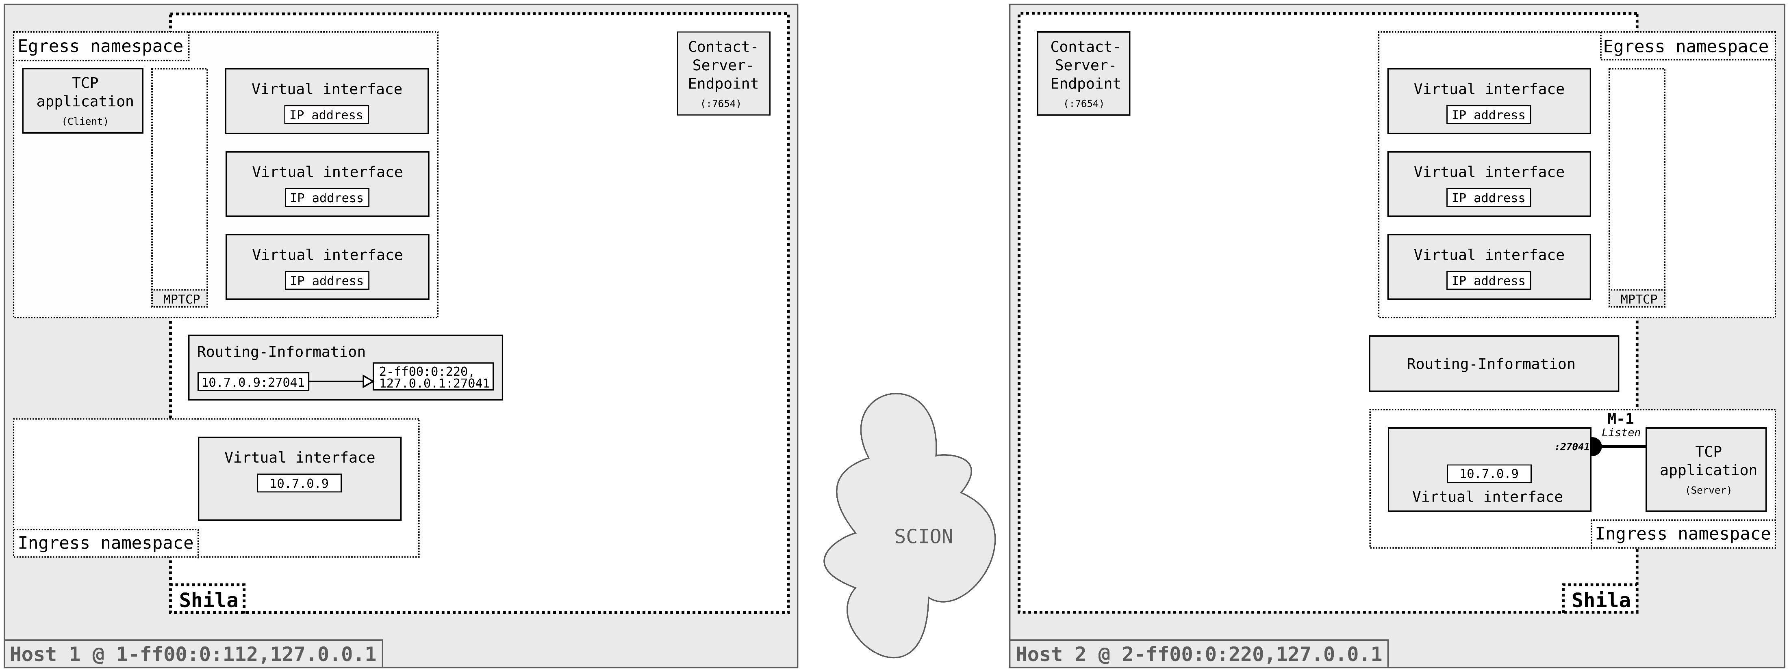
Projektanalyse – Folie 2
Functionality of Shila
Main-Flow Establishment

Slide 19

Projektanalyse – Folie 2
Functionality of Shila
Main-Flow Establishment

Slide 20
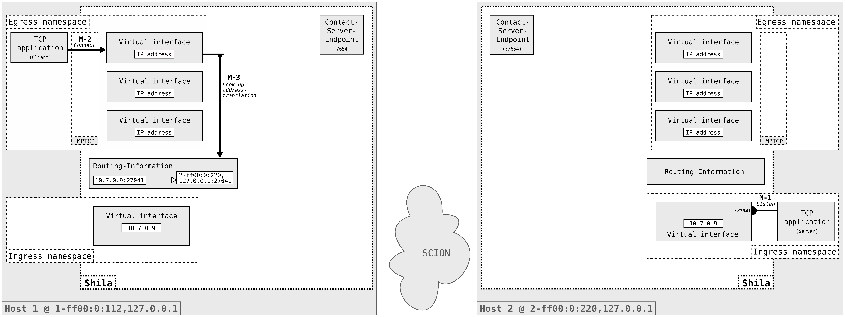
Projektanalyse – Folie 2
Functionality of Shila
Main-Flow Establishment

Slide 21
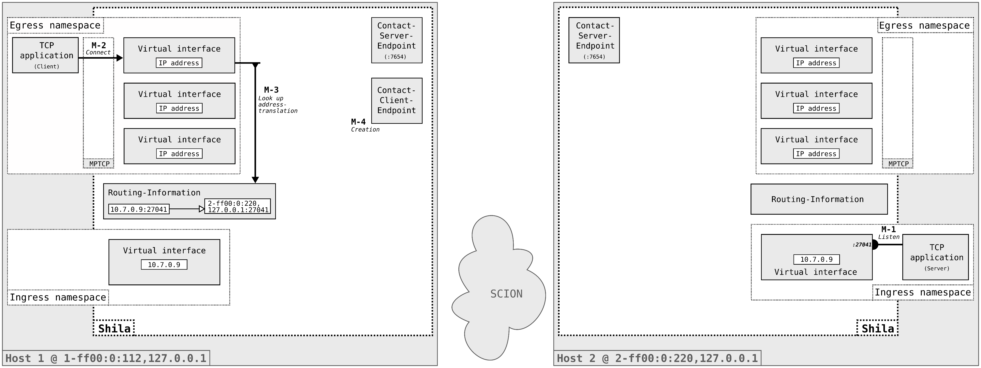
Projektanalyse – Folie 2
Functionality of Shila
Main-Flow Establishment

Slide 22

Projektanalyse – Folie 2
Functionality of Shila
Main-Flow Establishment

Slide 23

Projektanalyse – Folie 2
Functionality of Shila
Main-Flow Establishment

Slide 24

Projektanalyse – Folie 2
Functionality of Shila
Main-Flow Establishment

Slide 25

Projektanalyse – Folie 2
Functionality of Shila
Main-Flow Establishment

Slide 26
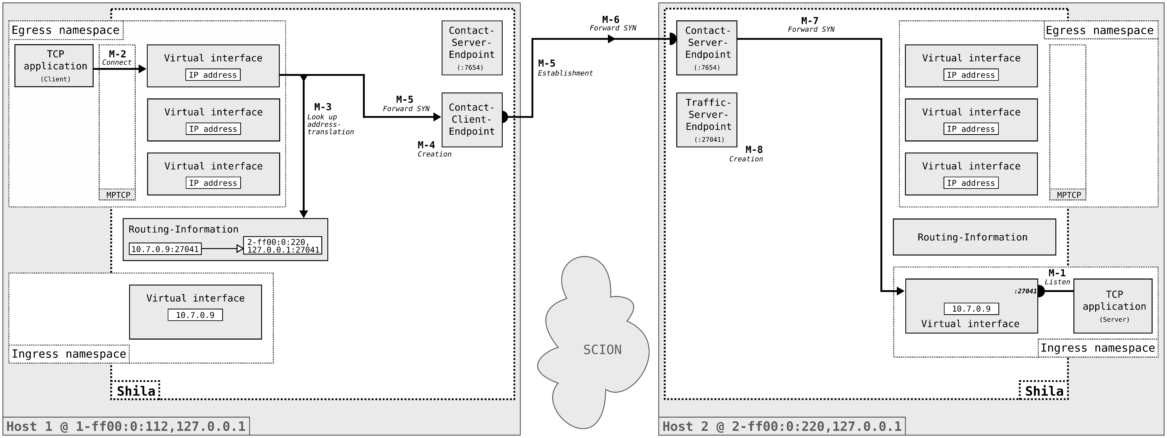
Projektanalyse – Folie 2
Functionality of Shila
Main-Flow Establishment

Slide 27
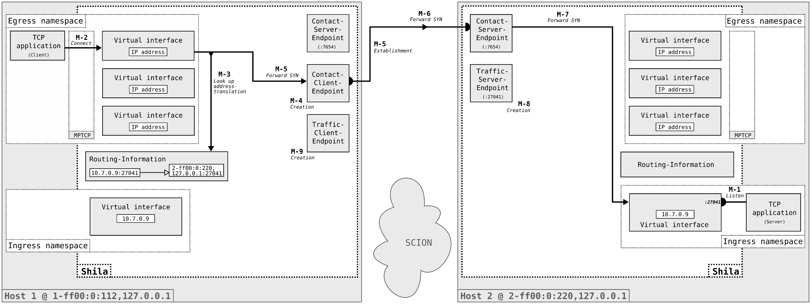
Projektanalyse – Folie 2
Functionality of Shila
Main-Flow Establishment

Slide 28

Projektanalyse – Folie 2
Functionality of Shila
Main-Flow Establishment

Slide 29
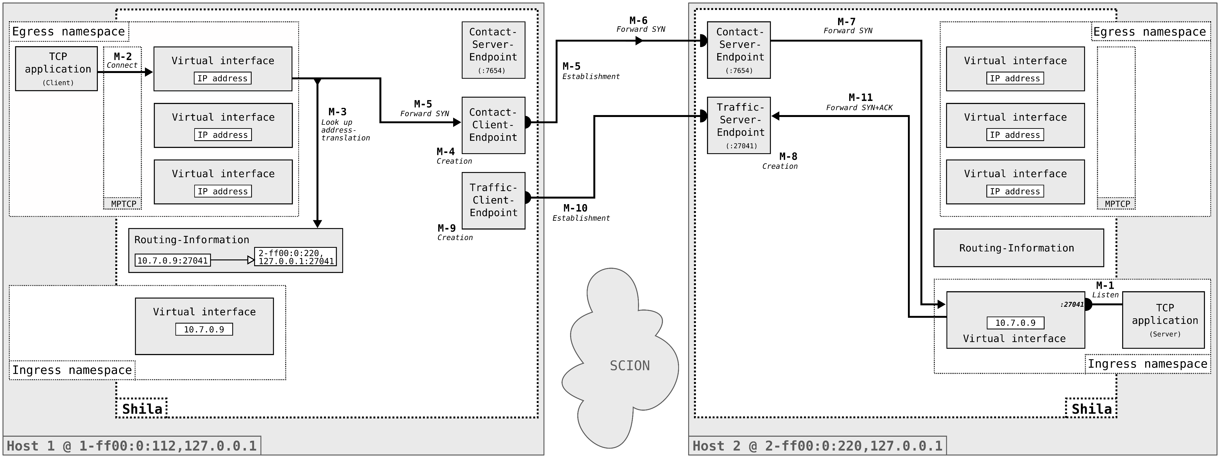
Projektanalyse – Folie 2
Functionality of Shila
Main-Flow Establishment

Slide 30

Projektanalyse – Folie 2
Functionality of Shila
Main-Flow Establishment

Slide 31
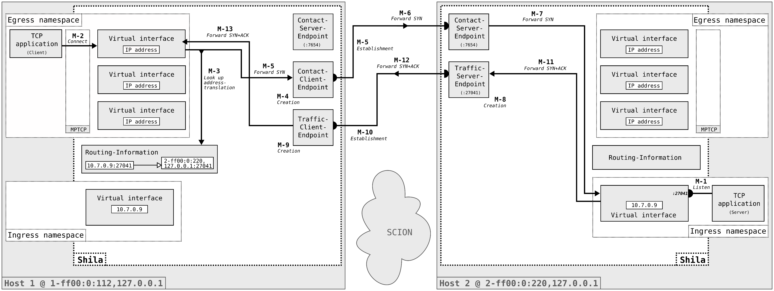
Projektanalyse – Folie 2
Functionality of Shila
Main-Flow Establishment

Slide 32
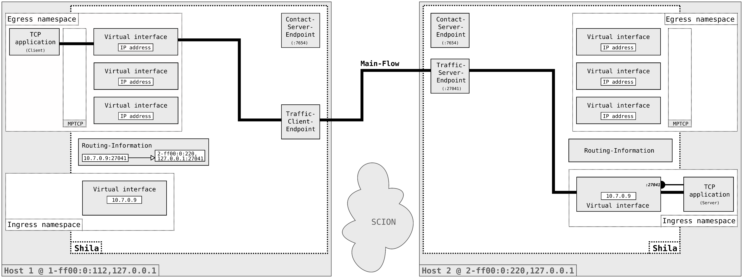
Projektanalyse – Folie 2
Functionality of Shila
Main-Flow Establishment

Slide 33

Projektanalyse – Folie 2
Functionality of Shila
Sub-Flow Establishment

Slide 34
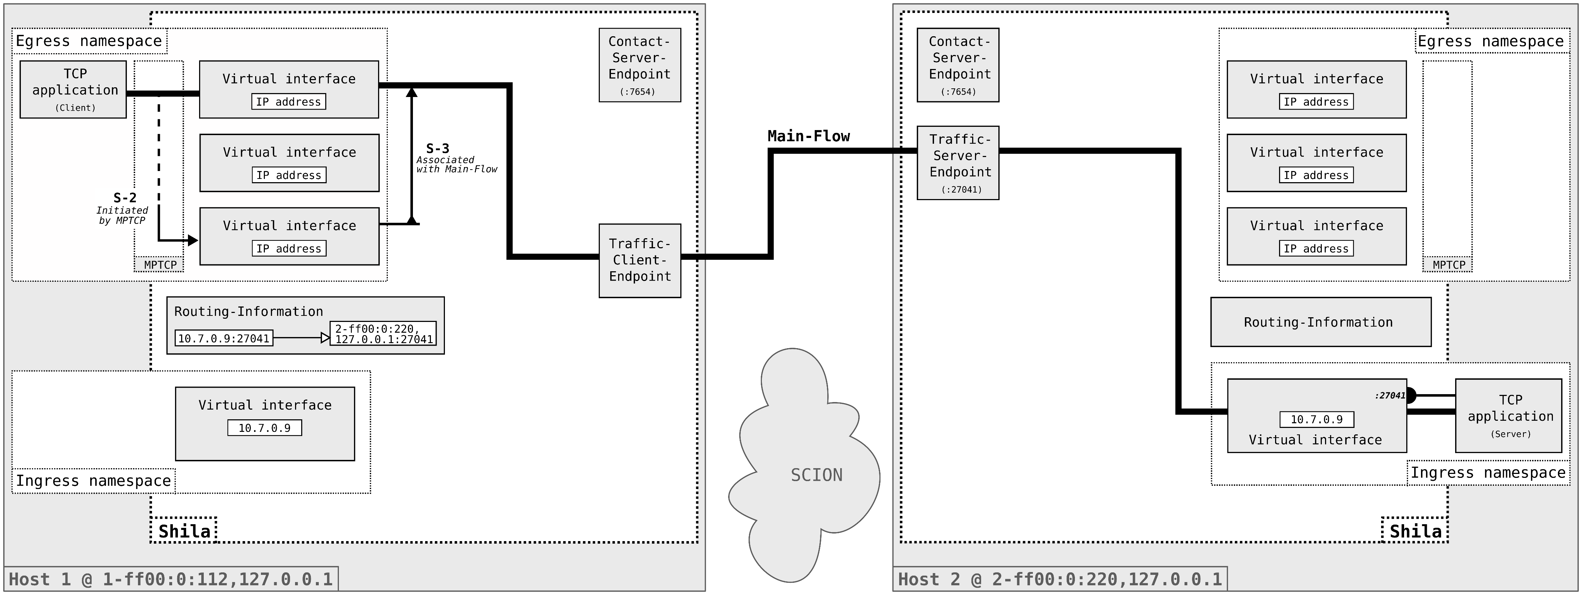
Projektanalyse – Folie 2
Functionality of Shila
Sub-Flow Establishment

Slide 35
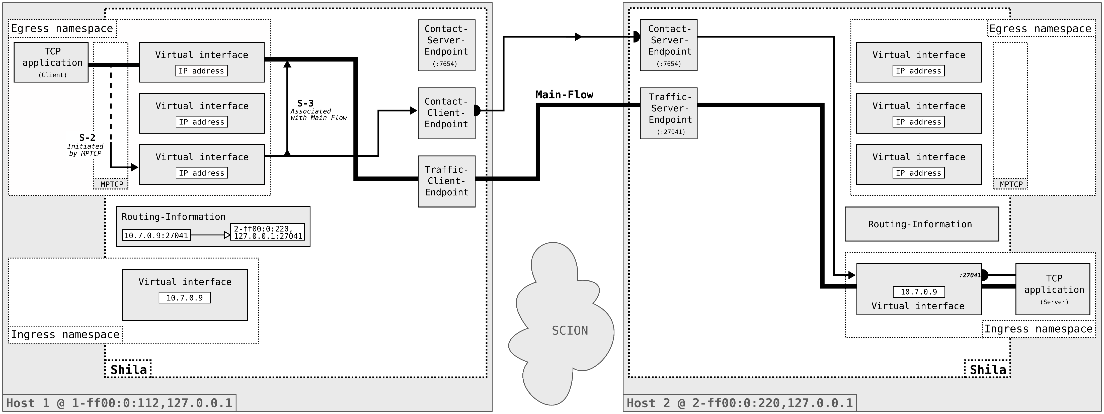
Projektanalyse – Folie 2
Functionality of Shila
Sub-Flow Establishment

Slide 36
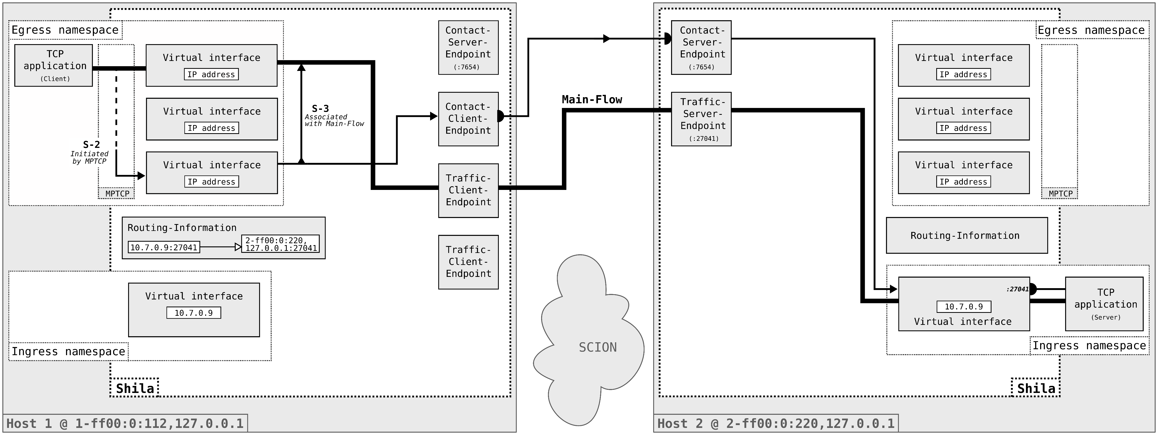
Projektanalyse – Folie 2
Functionality of Shila
Sub-Flow Establishment

Slide 37
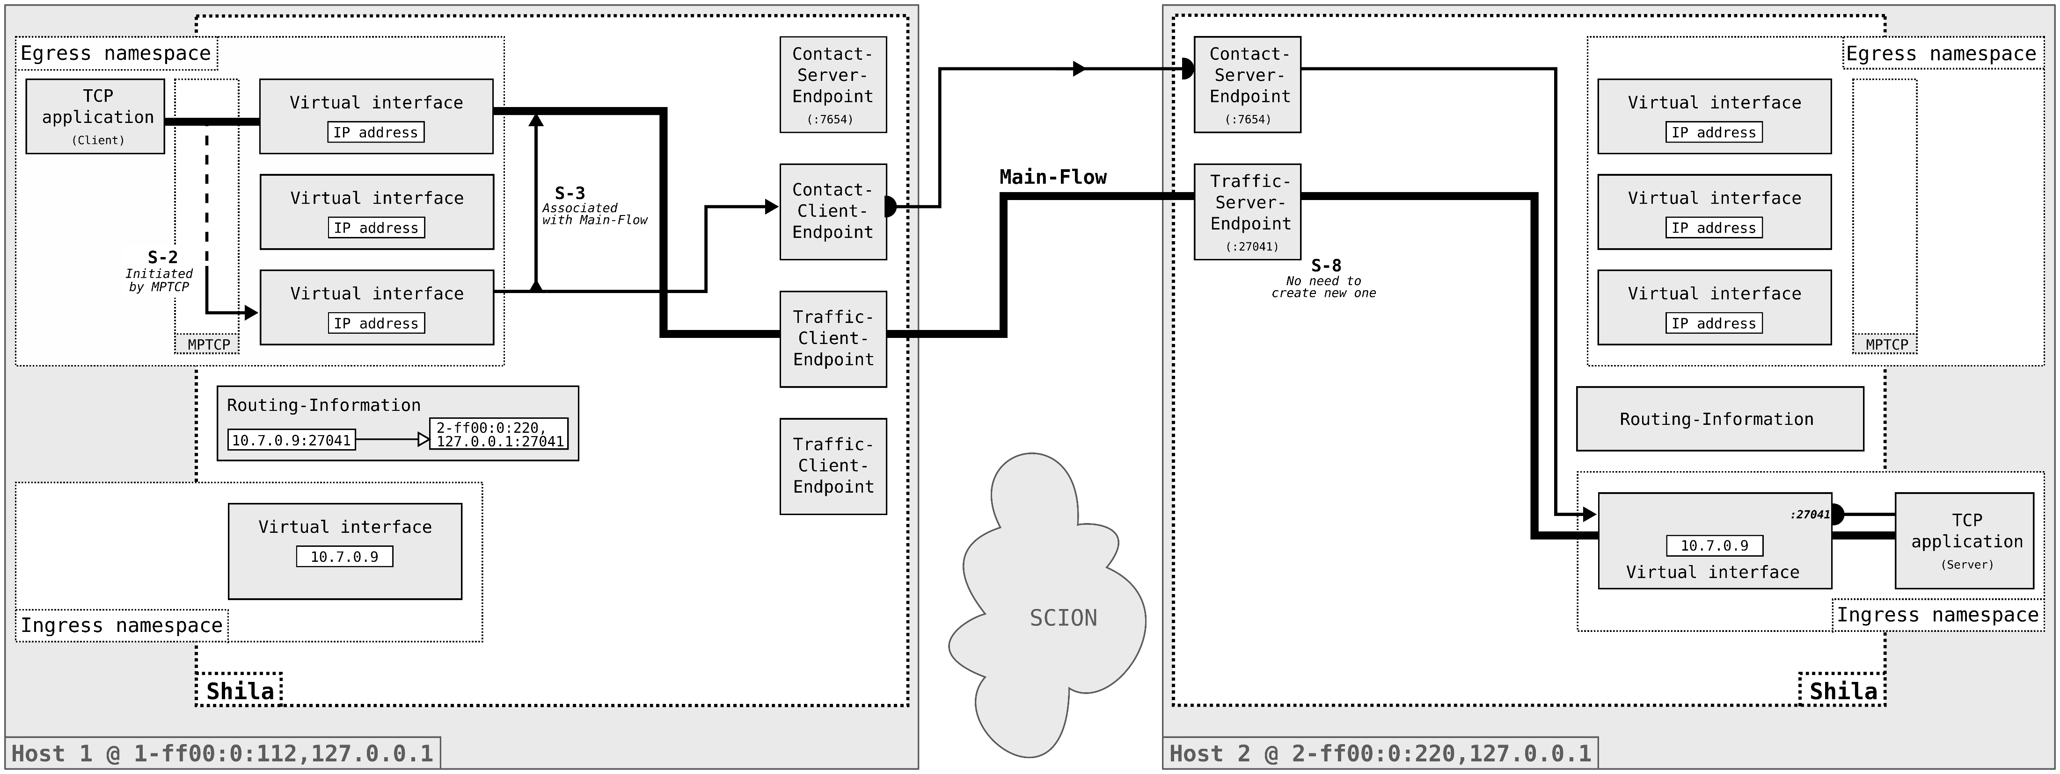
Projektanalyse – Folie 2
Functionality of Shila
Sub-Flow Establishment

Slide 38

Projektanalyse – Folie 2
Functionality of Shila
Sub-Flow Establishment

Slide 39

Projektanalyse – Folie 2
Functionality of Shila
Sub-Flow Establishment

Slide 40
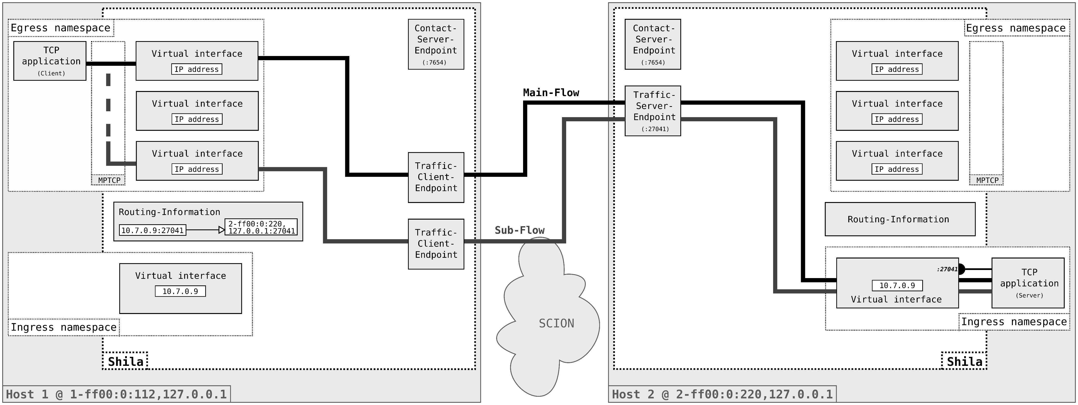
Projektanalyse – Folie 2
Functionality of Shila
Data Exchange

Slide 41
Projektanalyse – Folie 2
On the menu
Introduction
Functionality of Shila
Performance evaluation
Future work
Notes:
Introduction: What ingredients? What? Why?
Shila: How? (Setup – Connection establishment – Data transfer)
Performance: How good?
Future work: What is next?

Slide 42





Projektanalyse – Folie 2
Functionality of Shila
Initial situation
SCION
Scalability, control and isolation on next-generation networks
Neuartige Architektur des Internets entwickelt durch die ETH
Redesign von bestehenden Protokollen
Vermindert Vormachtstellung der USA
Nutzer haben Einfluss auf Pfad
SCION

Slide 43


Projektanalyse – Folie 2
Shila
Shila (Shim layer)
Ermöglicht Nutzung von MPTCP in der SCION Internet-Architektur
Prototyp - keine Änderung am Kernel notwendig
Erstellt und überwacht virtuelle Schnittstellen
Kontrolliert Datenfluss für jede Verbindung
virtuell
virtuell
Shila
Shila
SCION
virtuell

Slide 44



Projektanalyse – Folie 2
Warum?
Kontrolle der Pfade erlaubt Lockerung von Fairness-Algorithmus, was höhere Datenraten ermöglicht.
Congestion Control
Shila
Shila
SCION

Slide 45
Projektanalyse – Folie 2
Abschluss
Implementing and Evaluating MPTCP on the
SCION Future Internet Architecture
Kombination eines bestehenden Transportprotokolls mit einer neuartigen Internet-Architektur zwecks Optimierung der Übertragungsgeschwindigkeit.

Slide 46
Thank you.

Slide 47

Shila as a girls’ name means ”blind”. Shila is a varian form of Sheila (Irish, Gaelic): version of Sile.
STARTS/ENDS WITH Sh-, -la

Slide 48
Projektanalyse – Folie 2
Functionality of Shila
Th
Extension to TCP

